Slide 1
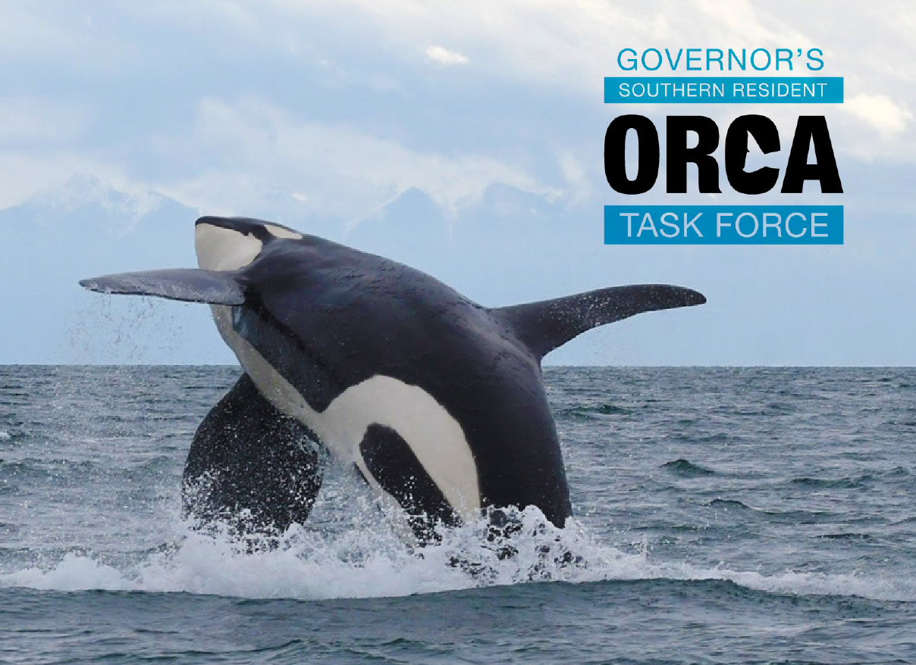
Orca Task Force
Notes:
Unit
This slideshow is part of Lesson 7 of the Saving the Southern Resident Killer Whales project-based learning unit. This unit can be downloaded for free from the NOAA Fisheries website. For questions or comments about this unit, please email wcr.education@noaa.gov.
Note
The issues presented in this activity have been simplified for classroom use and do not fully represent the complexities and delicacies of the real Task Force. See the Southern Resident Orca Task Force Report and recommendations from November 16, 2018 for the real recommendations.
Photo Credits
Southern Resident Orca Task Force

Slide 2
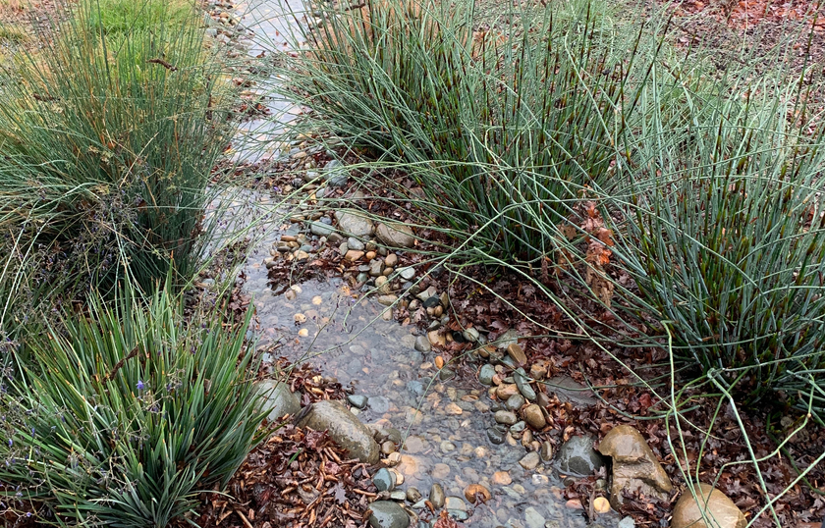
Water Quality Standards
Increase Water Quality Standards
Increasing water quality standards would create cleaner waterways. This proposal would also fund solutions, like bioswales and rain gardens, to clean up runoff. This can help more salmon survive. It can also reduce the amount of contaminants that accumulate in the Southern Residents.
Notes:
Photo Credits
Shutterstock

Slide 3
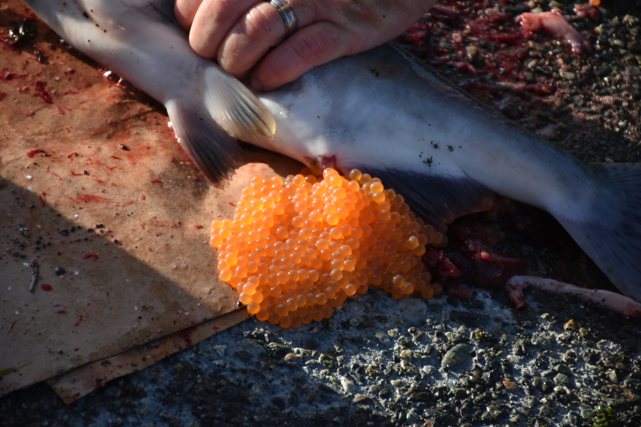
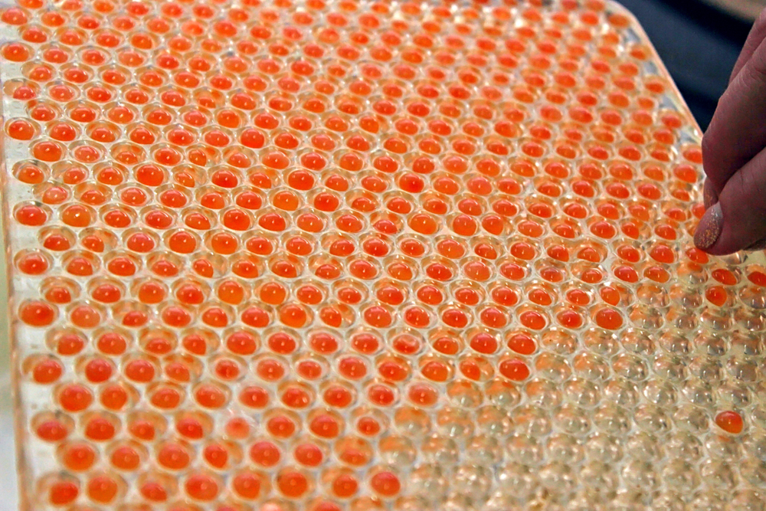
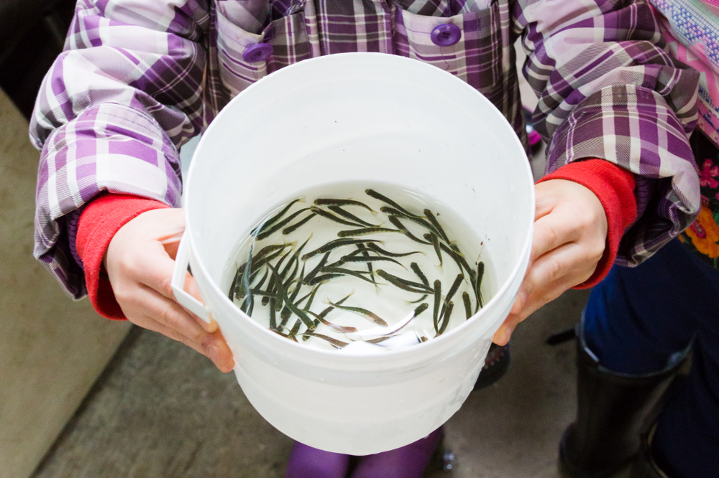
Hatchery Production
Increase Hatchery Production Increase the amount of Chinook salmon being produced in hatcheries. This is the quickest way to get more salmon in the mouths of the Southern Residents.
7
20
Notes:
Photo Credits
Shutterstock

Slide 4
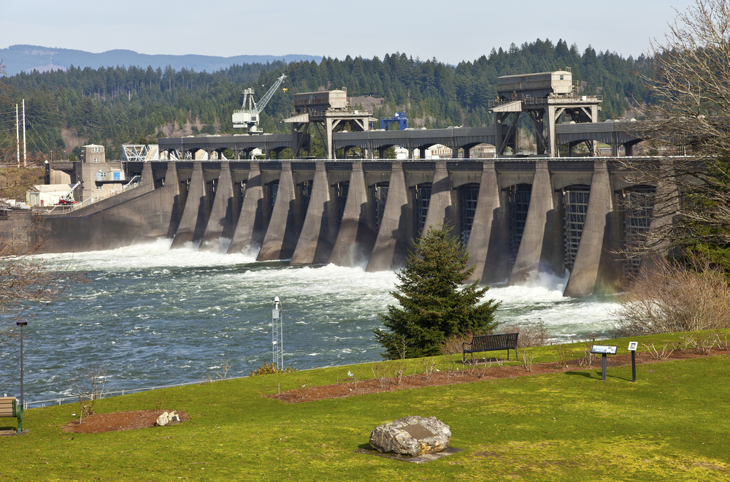
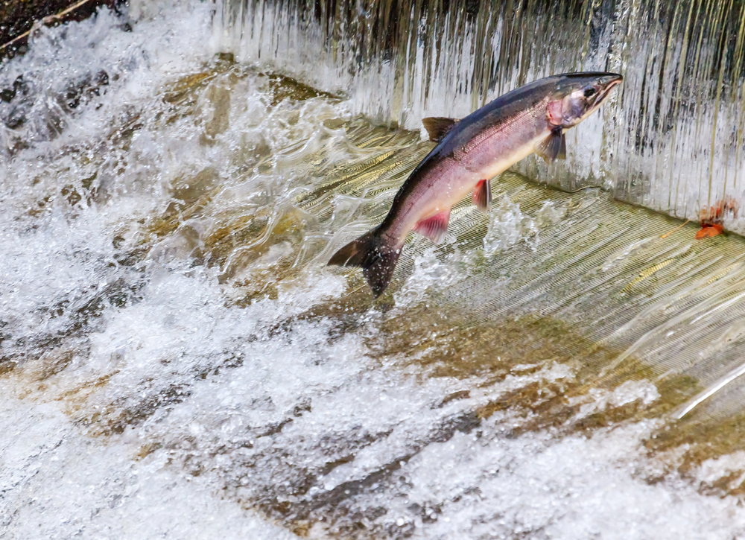
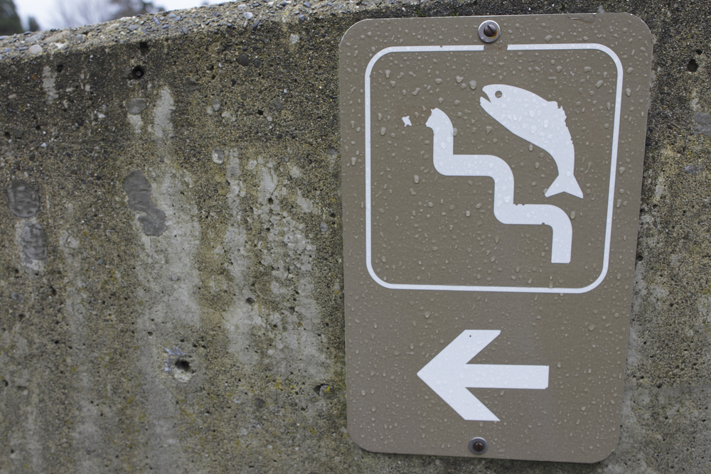
Dam Removal
Remove Problematic Dams Some dams pose a substantial obstacle to salmon recovery. Removal of problematic dams and barriers are important for recovering salmon.
Notes:
Photo Credits
Shutterstock

Slide 5
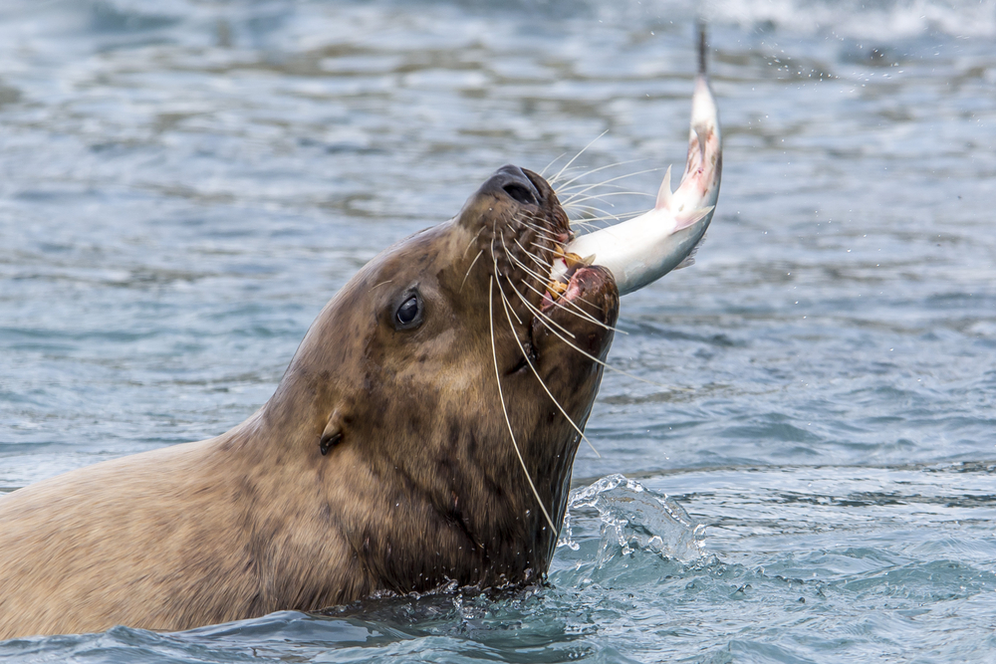
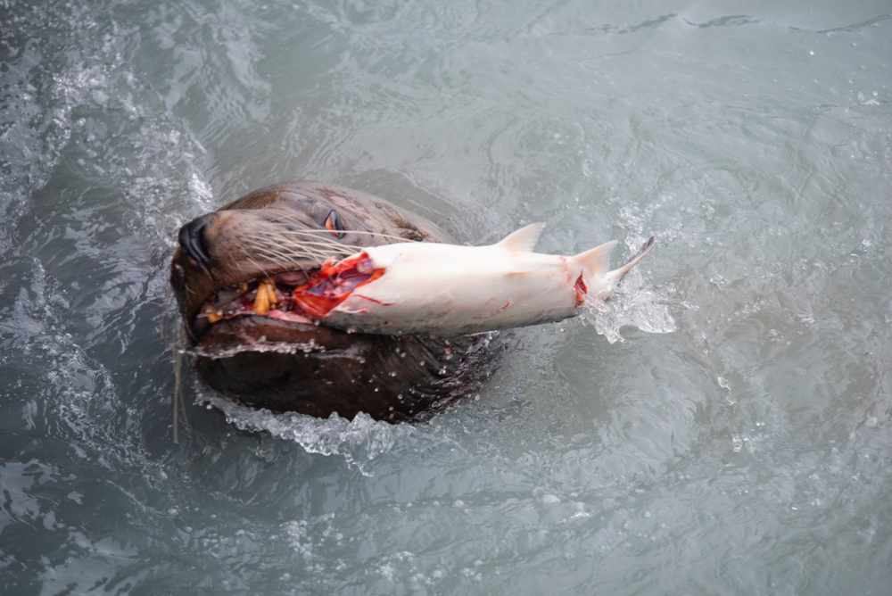
Pinniped Removal
Remove Problematic Pinnipeds
Populations of some pinnipeds (e.g. seals and sea lions) have greatly increased over the last few decades. Some pinnipeds gather at the mouths of dams and eat lots of Chinook salmon. This proposal would make it easier for officials to kill problematic pinnipeds.
Notes:
Photo Credits
Shutterstock

Slide 6
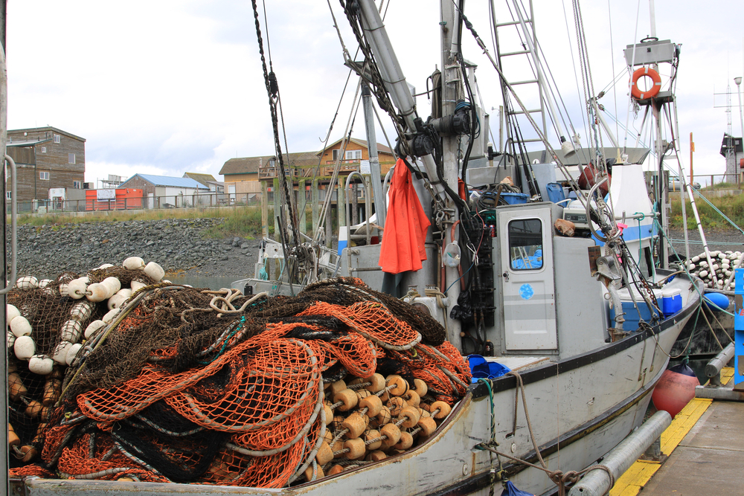
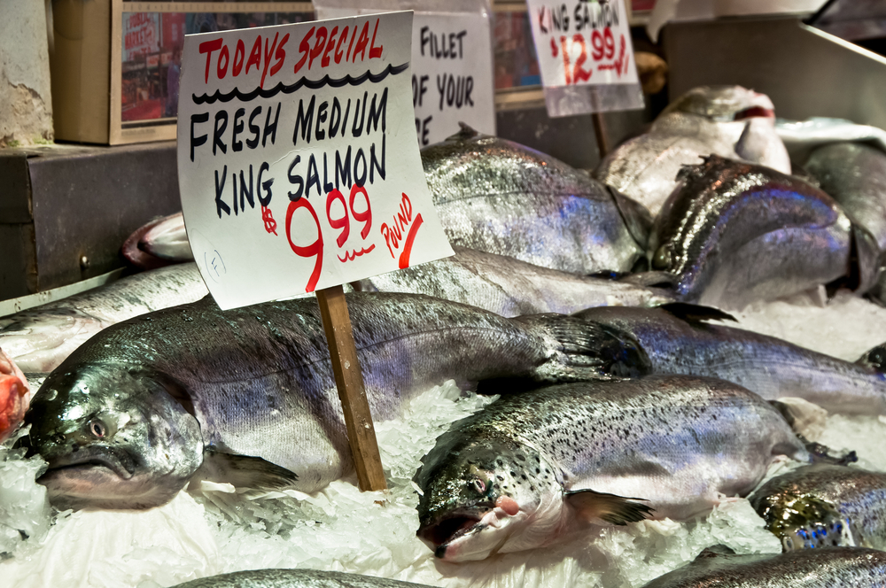
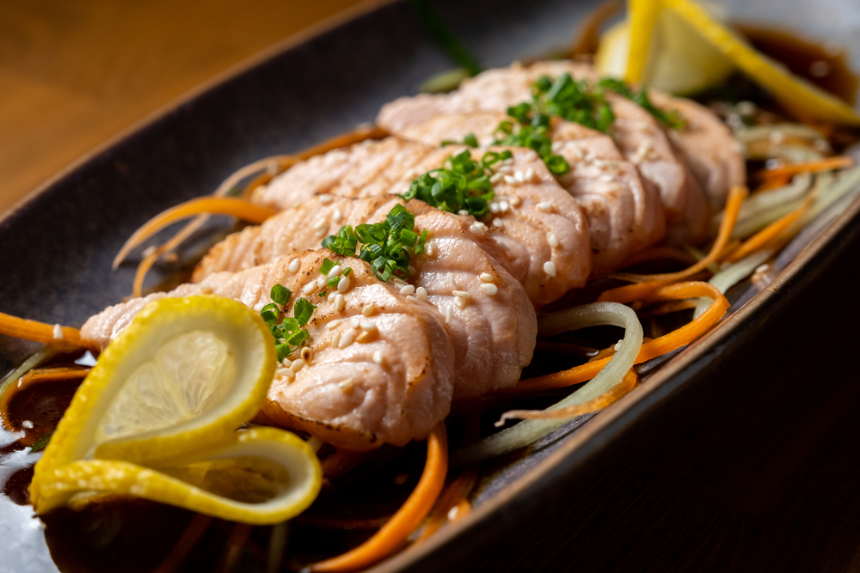
Chinook Fishing Restrictions
Chinook Fishing Restrictions
Since the Southern Residents desperately need more Chinook, this proposal would seek a temporary ban on commercial and recreational Chinook fishing. This ban would not apply to subsistence fishing.
Notes:
Photo Credits
Shutterstock

Slide 7
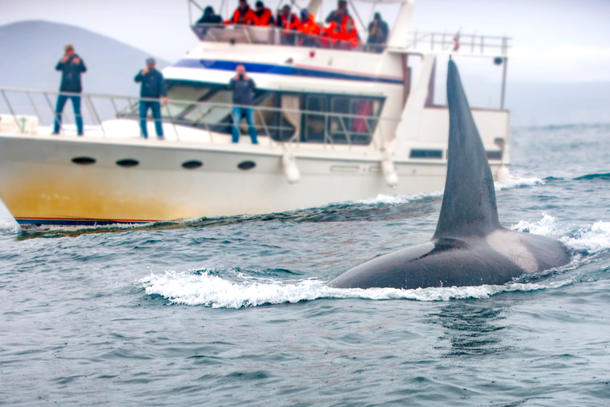
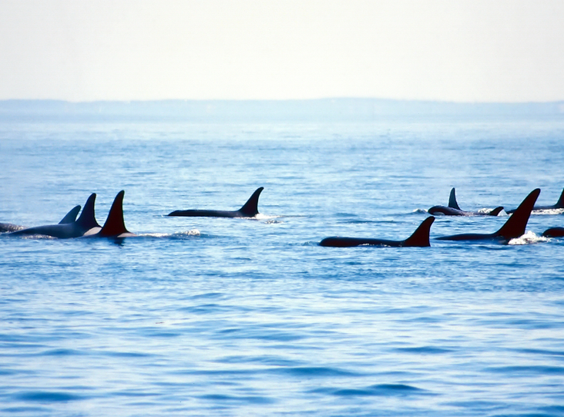
Vessel Restrictions
Vessel Restrictions
Boat traffic and noise interferes with the Southern Resident’s ability to hunt for salmon and rest. This proposal would require boats to stay at least 400 yards away from the Southern Residents. It would also place a temporary ban on commercial whale watching tours.
Notes:
Photo Credits
Shutterstock

